Slide 1
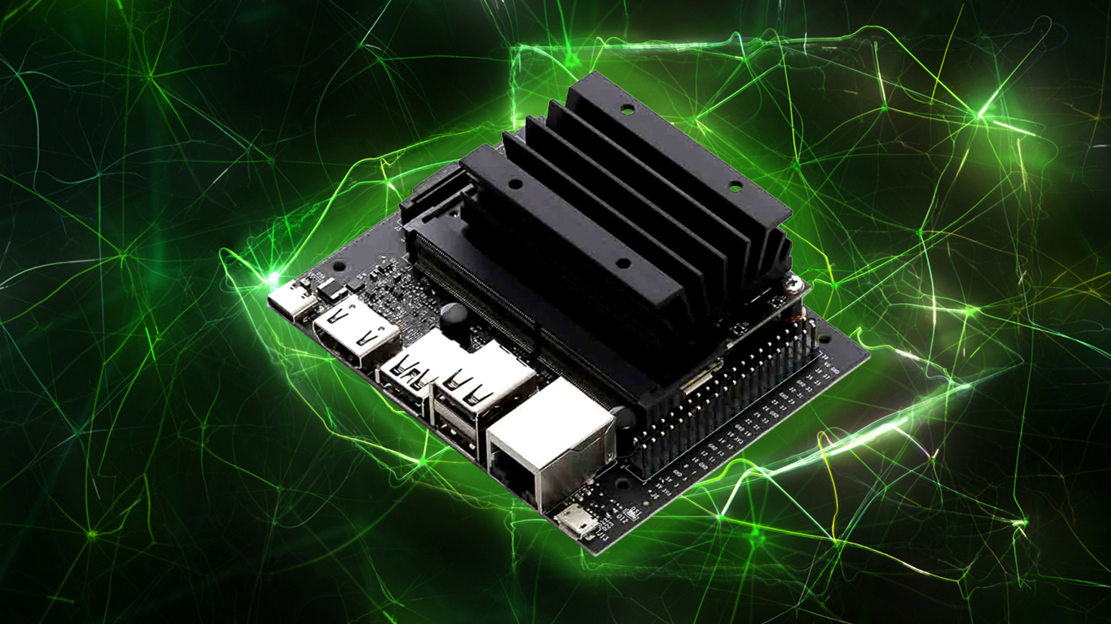
Smart refrigerator using ai
Part b
Supervisor: Mony Orbach
Students: Raghad Badarny, Mohammed Ghanaiem
Spring 2023-2024
PDR Presentation

Slide 2
Background and Motivation
Following the completion of part A, efforts were made to improve the project’s user-friendliness.
This involved creating a system that receives data from the cloud witch itself gets the data from many smart refrigerators.
Developing an application and integrating the project with cloud services, allowing the lists to be presented directly within the application.

Slide 3
Project Goal
Connect to cloud, so it can handle and serve many users , so all refrigerators send their data to it.
Store data in the cloud while ensuring that each user’s data is kept distinct and separate from other since there are many users connected to it.
Build an application with a username and password for each user.
Encode the data in the cloud and secure the system.

Slide 4
Development environment
Development environment: linux.
Coding language: Python.
cloud’s development environment – yet to be chosen.

Slide 5
Hardware Components
All components are from part A:
Webcam
Jetson Nano
touch screen

Slide 6
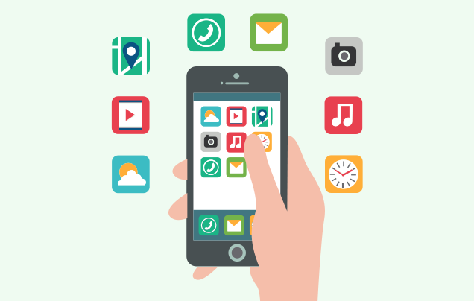
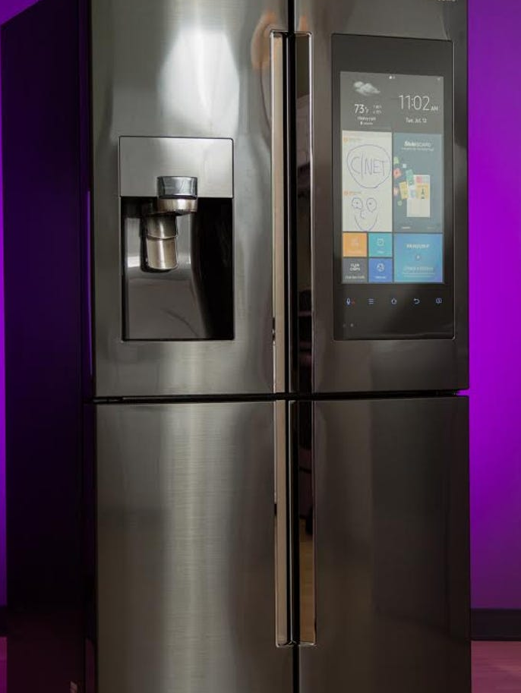
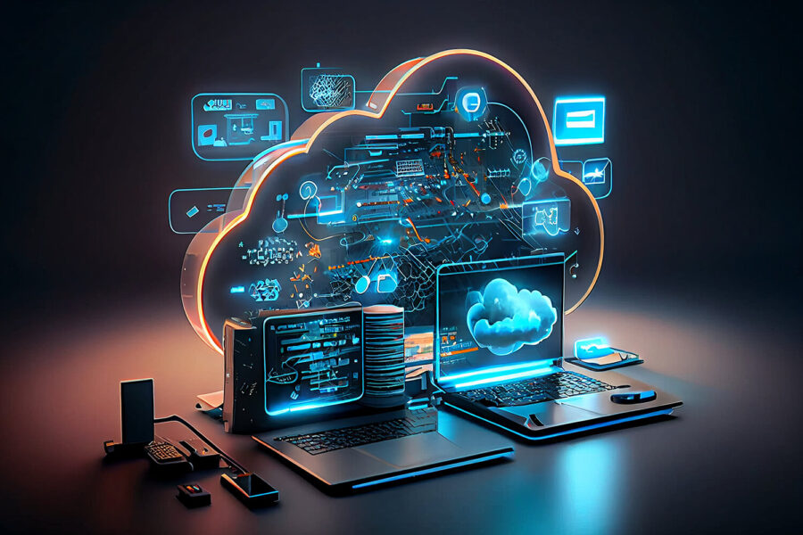
Block Diagram – How it’s connected

Slide 7
Cloud And It’s Responsibilities
Encoding Data
Memory
Managing lists
Managing many users

Slide 8
Application
User should log in using a username and password.
It should display main lists:
- Shopping list
- Expired list
-Expiring soon list

Slide 9
Timetable
Goal | Week
PDR PowerPoint Get familiar with clouds | 1 (18.8.24 - 24.8.24)
Choose which cloud | 2 (25.8.24 - 31.8.24)
Exams Break (1.9.24 – 19.10.24)
Learn encoding data | 3 (20.10.24 - 26.10.24)
 | 4 (27.10.24 - 2.11.24)
Learn how to build an application | 5 (3.11.24 - 9.11.24)
 | 6 (10.11.24 - 16.11.24)
Connect to cloud | 7 (17.11.24 – 23.11.24)
 | 8 (24.11.24 – 30.11.24)
Build an application | 9 (1.12.24 – 7.12.24)
 | 10 (8.12.24 – 14.12.24)

